Slide 1

Introduction to Python
A course review
by Elliot Cooke

Slide 2






Today

Slide 3

What is it?

Slide 4
Context & Relevance
Is it clear why you’re learning each topic?
Are real‑world use cases or analogies provided?
3

Slide 5
Course Structure
Is the curriculum ordered logically (prereqs before advanced topics)?
Are topics grouped clearly rather than scattered?
7

Slide 6
Content Quality
Is enough covered?
Do exercises and examples reinforce core concepts?
Are the explanations accurate, clear, and free of errors?
4

Slide 7
Flow & Interactivity
Do quizzes/tutorials match what was just taught?
Is there enough practice to cement learning before moving on?
Are there hands‑on labs, interactive code editors, or peer exercises?
4
Does the course ask you to actively code every step?

Slide 8

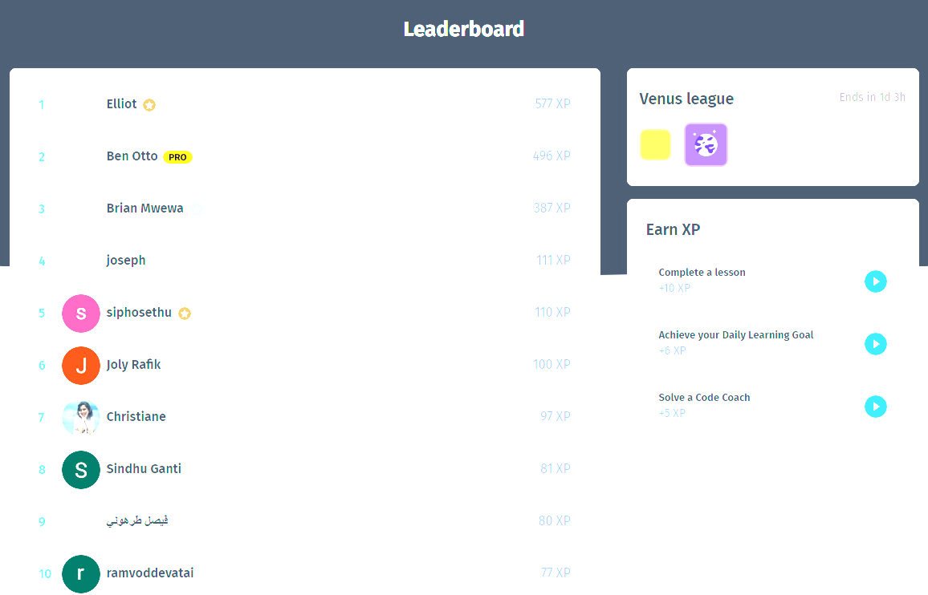


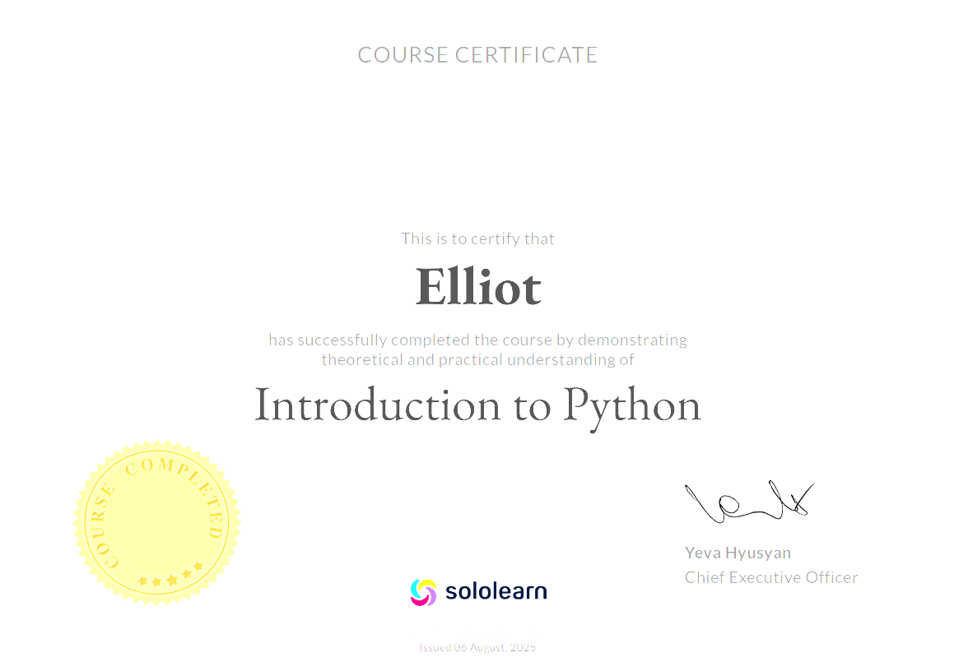
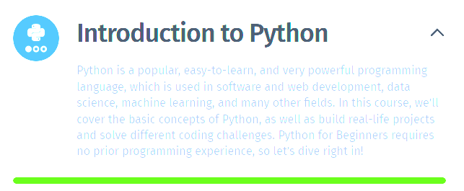
The best bit

Slide 9
Pacing
Does energy stay consistent across the full runtime?
Is the speed appropriate, never too slow
(boring) or too fast (overwhelming)?
7

Slide 10
Production Medium
Is the UI smooth, intuitive to navigate?
Is any audio/video on screen detracting or badly edited?
7

Slide 11
Value
Does it feel “premium” enough that you wouldn’t mind paying?
Is it worth the price?
5

Slide 12
Je ne Sias Quoi
1

Slide 13



RECAP

Slide 14
Summary
 | LearnPython.org | Sololearn (Free) Python Introduction | Next course will go here
Context & Relevance | 2 | 3
Course Structure | 5 | 7
Content Quality | 9 | 4
Flow & Interactivity | 6 | 4
Pacing | 6 | 7
Production & Medium | 7 -> 5 | 7
Value | 8 | 5
Je ne sais quoi | 2 | 1
Total | 45 -> 43 / 75 | 38/75

Slide 15

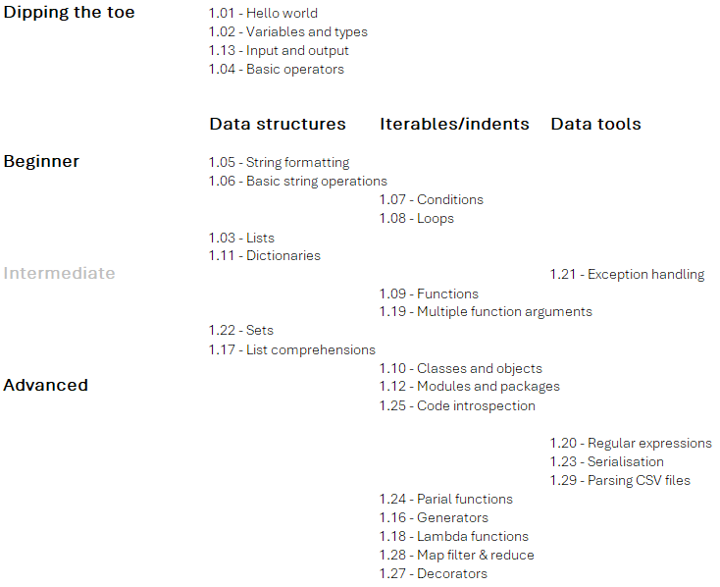



Improvement suggestions?
https://github.com/ElliotCookie

